Slide 1
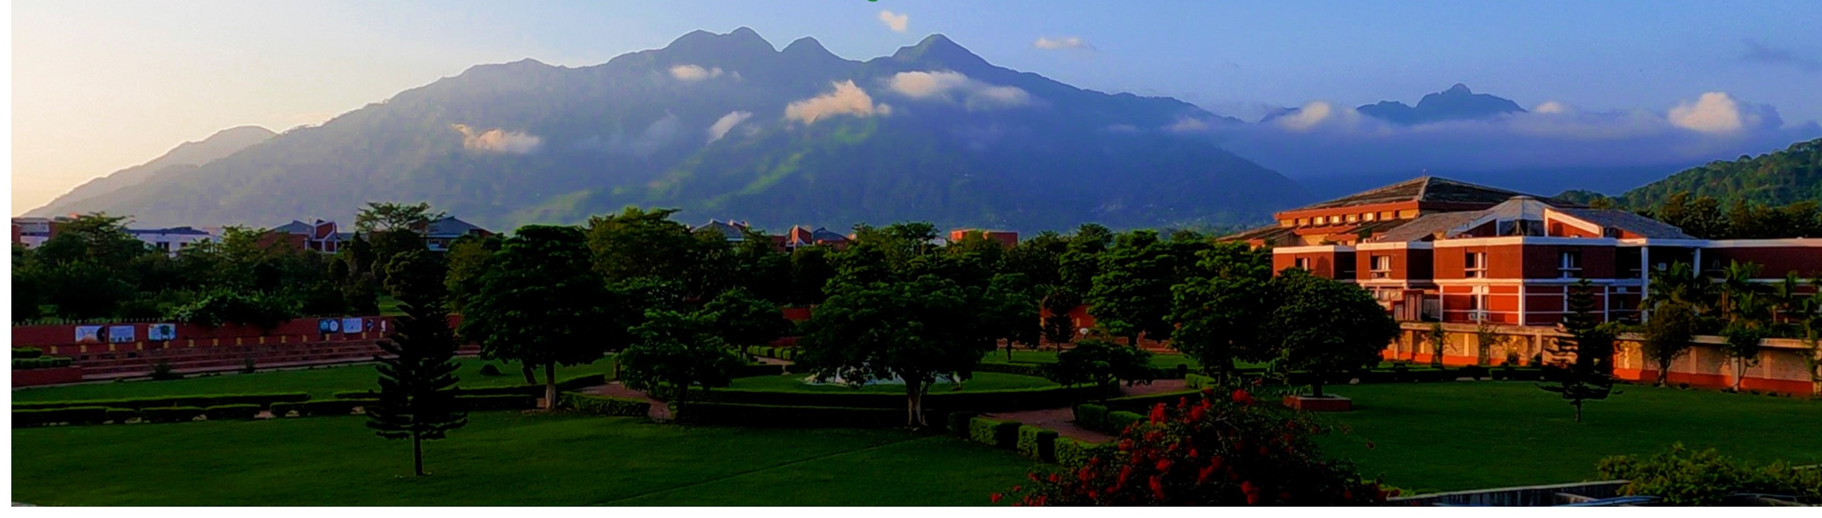

Digital Marketing

Slide 2
SUMMER INTENSHIP -II
SUBMITTED TO: Dr. BAIJNATH KAUSHIK
SUBMITTED BY: ABHINAV MAURYA
ENTRY NUMBER:19BCS003
FUNDAMENTALS OF DIGITAL MARKETING

Slide 3
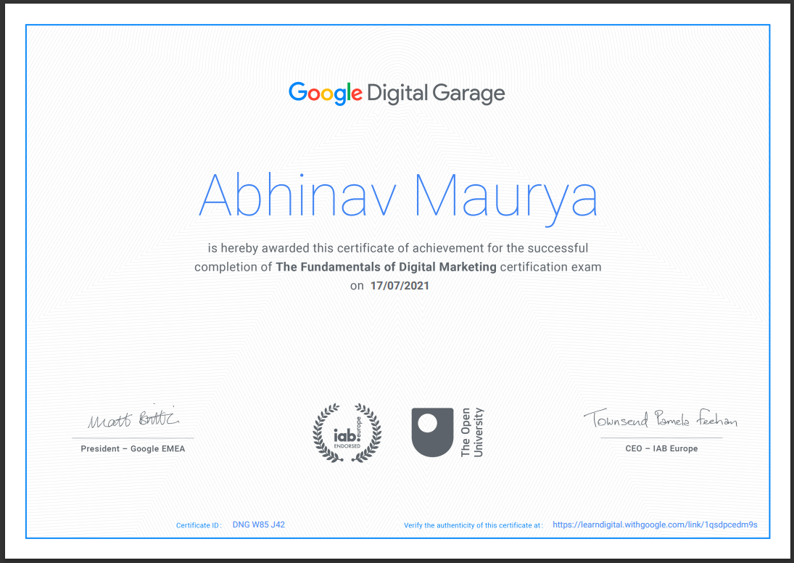
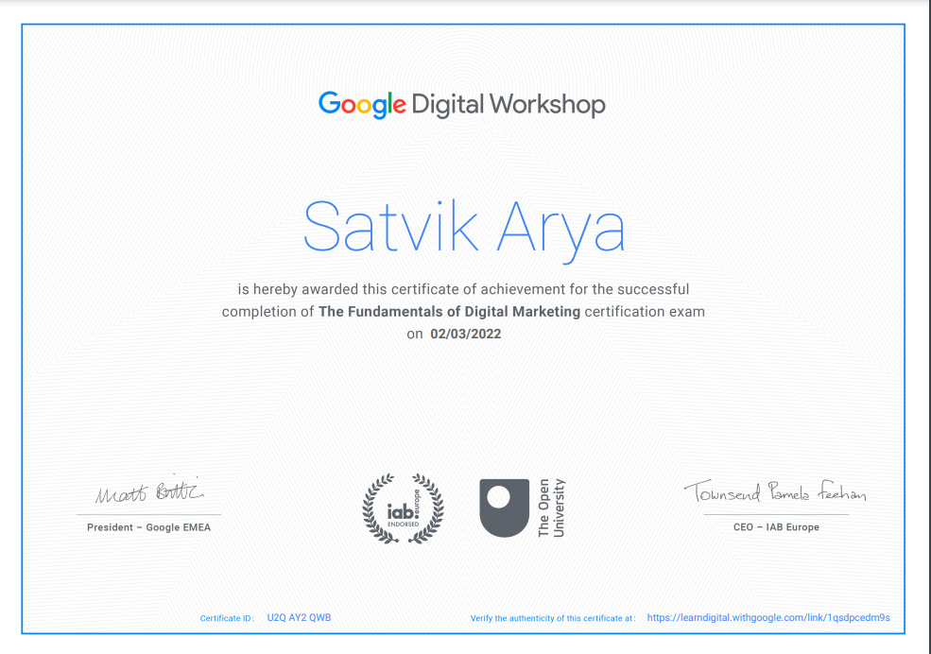

Slide 4
Marketing Applications
Digital Marketing
What is digital marketing?
  Digital marketing can be described as actively promoting products and services using digital distribution channels as an alternative to the more traditional mediums such as television, print and radio

Slide 5
Marketing Applications
Digital Marketing
What is Digital Marketing?
Today’s consumer is more cognizant of the marketing messages all around them, leaving them more likely to tune out advertisements or other forms of marketing communication
In the “golden age” of television, an ad on one of
the big three networks could reach 70 percent of
the viewing audience
According to Seth Godin (author of Permission
Marketing) today’s consumer receives roughly one
million marketing messages a year on average

Slide 6
Types of digital marketing
There are as many specializations within digital marketing as there are ways of interacting using digital media. Here are a few key examples.
Search engine optimization
Search engine optimization, or SEO, is technically a marketing tool rather than a form of marketing in itself. The Balance defines it as “the art and science of making web pages attractive to search engines.”
The "art and science" part of SEO is what’s most important. SEO is a science because it requires you to research and weigh different contributing factors to achieve the highest possible ranking. Today, the most important elements to consider when optimizing a web page include:
Quality of content
Level of user engagement
Mobile-friendliness

Slide 7
CONTENT MARKETING
Content marketing matters, and there are plenty of stats to prove it:
84% of consumers expect companies to produce entertaining and helpful content experiences
62% of companies that have at least 5,000 employees produce content daily
92% of marketers believe that their company values content as an important asset

Slide 8
SOCIAL MEDIA MARKETING
Social media marketing offers built-in engagement metrics, which are extremely useful in helping you to understand how well you're reaching your audience. You get to decide which types of interactions mean the most to you, whether that means the number of shares, comments, or total clicks to your website.
Direct purchase may not even be a goal of your social media marketing strategy. Many brands use social media marketing to start dialogues with audiences rather than encourage them to spend money right away. This is especially common in brands that target older audiences or offer products and services not appropriate for impulse buys. It all depends on your company's goals.

Slide 9
Pay-per-click marketing
Pay-per-click, or PPC, is posting an ad on a platform and paying every time someone clicks on it.
How and when people see your ad is a bit more complicated. When a spot is available on a search engine results page, also known as a SERP, the engine fills the spot with what is essentially an instant auction. An algorithm prioritizes each available ad based on a number of factors, including:
Ad quality
Keyword relevance
Landing page quality
Bid amount

Slide 10
Marketing Applications
Digital Marketing Strategies
How are marketers adjusting?
Digital marketers turn to technology to help reach target consumers
Internet marketing
Mobile marketing
Social marketing
Viral marketing

Slide 11
Marketing Applications
Digital Marketing
How are marketers adjusting?
The goal for digital marketers is to focus on interactive elements, encouraging consumers to participate in the marketing process
Indian interactive marketing spending will reach $75 billion by 2023, making up 71% of all marketing spending, according to a report issued by Forrester Research

Slide 12
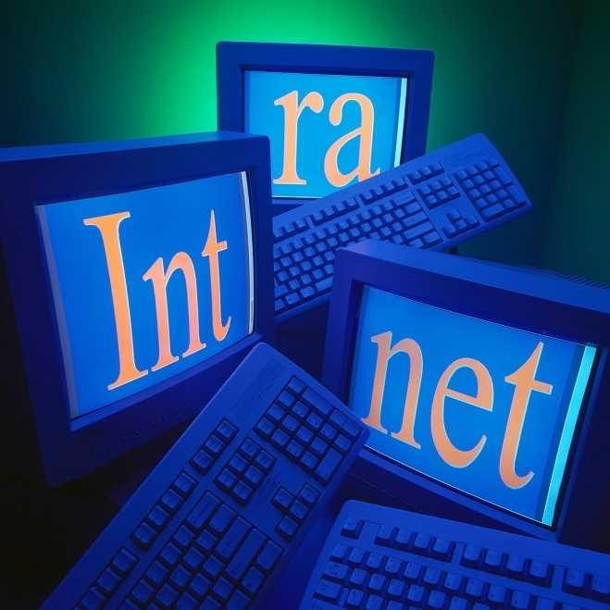
Marketing Applications
Digital Marketing Strategies
Internet Marketing
The Internet, far more than any other medium, has given consumers a voice, a publishing platform and a forum where their collective voices can be heard, shared and researched, creating a more powerful and educated audience than ever before

Slide 13
Marketing Applications
Digital Marketing Strategies
Consumer-Generated
Media (CGM)
Encompasses the millions of consumer-generated comments, opinions and personal experiences posted in publicly available online sources on a wide range of issues, topics, products and brands
Also referred to as Online Consumer Word-of-Mouth or Online Consumer Buzz

Slide 14
Digital Marketing Strategies
Consumer-Generated Media (CGM)
      Blogs
      Message boards and forums
      Social media
      Discussions and forums on large email portals .
      Online opinion/review sites and services/ feedback/complaint sites

Slide 15

Marketing Applications
Digital Marketing Strategies
Sports and entertainment properties use the Internet for a host of marketing functions
Ticket sales
Sponsorship sales
Merchandise sales
Additional revenue
streams (banner advertising
on team websites etc.)
Community relations
Player/staff fan connection
(blogs, chats etc.)
General promotion

Slide 16
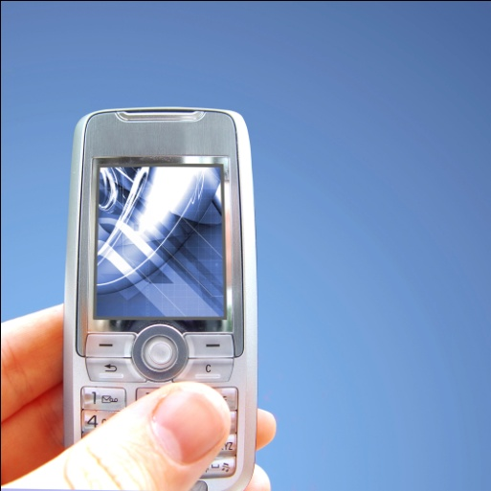
Marketing Applications
Digital Marketing Strategies
Mobile Marketing
Mobile marketing refers to two different marketing means: one refers to marketing on or with a mobile device (such as a mobile phone) while the other (more traditional) is meant to describe marketing “on-the-go”

Slide 17
Marketing Applications
Digital Marketing
Mobile marketing represents an area of massive potential growth
In 2020, Indians alone sent over 7.2 trillion text messages (that's an average of 88 messages per INDIAN each day)
Mobile advertising raked in $22 billion in 2020, an 82.8 percent increase from 2014. One of the main drivers of this growth is the fact that most consumers have mobile devices on them nearly all the time, and the always-connected nature of the device.

Slide 18
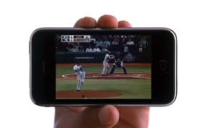
Marketing Applications
Digital Marketing
Mobile marketing represents an area of massive potential growth
In a study conducted in 2020, researchers found that nearly 59 percent of smartphone and tablet owners used their devices to watch television.

Slide 19
Marketing Applications
Digital Marketing Strategies
“Apps”
Apps are individual software programs designed to run on the Internet, computer, phone or other electronic device typically designed to increase functionality or ease of use
Apps have recently gained a lot of popularity among consumers

Slide 20
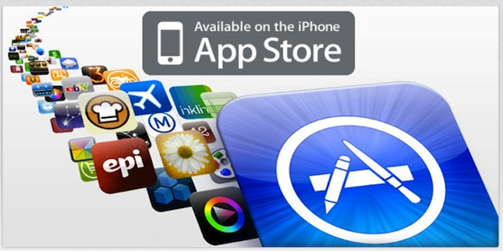
Marketing Applications
Digital Marketing Strategies
In June of 2021, Apple announced that 350 billion apps had been downloaded from their online “apps” store, up from 175 billion apps in June of 2017.

Slide 21
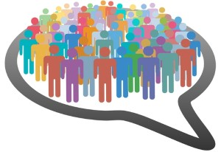
Marketing Applications
Digital Marketing Strategies
Social Media
Social media describes the online technologies and practices that people use to share content, opinions, insights, experiences, perspectives, media and to otherwise interact

Slide 22








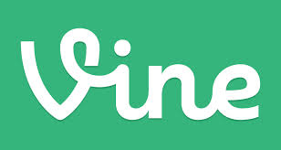
Marketing Applications
\
Digital Marketing Strategies
Social media presents itself in the form of many variable applications
Google+
Twitter
Flickr
Facebook
YouTube
Digg
MiniClip
foursquare
Vine

Slide 23
Digital Marketing
Why is social media important to a sports or entertainment marketer?
In theory, social media is free
Allows an organization to reach a massive
audience
3. Social media is still experiencing rapid growth,
presenting unlimited potential for marketers

Slide 24

Why is social media important to a sports or entertainment marketer?
Facebook: More than 3 active billion users
Google+: 1221 million active users, up 33 percent from the number of users in 2018
Linkedin: 996 million professionals and growing at more than two members per second, representing every company on the Fortune 500 in over 200 countries
Twitter: Over 555 million registered users, more than double the number of users in 2022 but users are actively engaged, “favoriting” more than 1.6 billion tweets in May of 2020 alone

Slide 25
Why is social media important to a sports or entertainment marketer?
YouTube: According to their website, over 67 billion hours of video are watched each month on YouTube—that's almost an hour for every person on Earth, and 50% more than last year

Slide 26
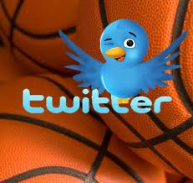
Digital Marketing Strategies
Social Media Marketing
Twitter’s popularity has exploded recently, in large part because it allows for the user to control the dialogue without any filter, creating a direct line of communication between the athlete, celebrity or sports/entertainment property and the fan

Slide 27
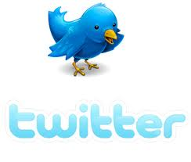
Digital Marketing Strategies
Social Media Marketing
1. When in Doubt, Tweet
2. Respect the Fan
3. Use the Resources You Have
4. Follow Back and Listen
5. If it isn’t Broken, Don’t Fix it

Slide 28
Digital Marketing Strategies
Location-based Marketing
Location based social networking allows users to “check into” businesses at a physical location using a mobile device while alerting their friends and contacts know where they are and, in some instances, to receive coupons and discounts at the establishment at which they are visiting (think of it as the convergence of social media and mobile marketing)

Slide 29
Digital Marketing Strategies
Viral Marketing
Viral marketing describes any strategy that encourages individuals to pass on a marketing message to others, creating the potential for exponential growth in the message's exposure and influence
Viral marketing is the digital marketer’s version of “word-of-mouth” advertising

Slide 30
Today’s consumer is more cognizant of the marketing messages all around them, leaving them more likely to tune out advertisements or other forms of marketing communication.
Digital marketers turn to technology to help reach target consumers. Marketers must be creative and innovative to connect with today’s consumer and target audiences.

Slide 31
Thanks

